Slide 1


Wine Quality Prediction Using Decision Tree, Random Forest, and Gradient Boosting
Comparative Performance Evaluation of Supervised Classification Algorithms
SUBMITTED BY (BATCH STUDENTS)
UNDER THE GUIDANCE OF
M. CharanTej Reddy — Roll No: 2520030422
Dr. Jyothsna Datti
Chandrakanth Reddy — Roll No: 2520030290
Professor, Department of Computer Science & Engineering
Program: Bachelor of Technology (B.Tech) - CSE
Koneru Lakshmaiah Education Foundation (KLH)

Slide 2


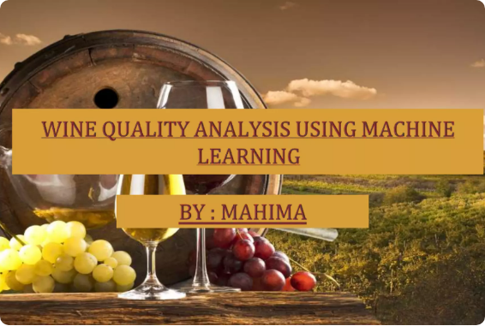
KLH CSE • ML PROJECT 2026
Project Abstract & Motivation
Industry Relevance: Wine quality certification relies heavily on expensive, subjective human sensory testing and laboratory evaluation.
Automated Assessment: Machine Learning enables fast, objective quality scoring derived strictly from measurable physicochemical parameters.
Core Research Objective: Implement, tune, and rigorously compare 3 tree-based classifiers—Decision Tree, Random Forest, and Gradient Boosting.
Key Metric Focus: Evaluate performance using Accuracy, Precision, Recall, and F1-Score to establish the most reliable predictive model.
Department of Computer Science & Engineering

Slide 3

KLH CSE • ML PROJECT 2026
Wine Dataset & Features
Feature Name | Chemical Measurement | Impact on Wine Profile
Volatile Acidity | g(acetic acid)/dm³ | High levels cause an undesirable vinegar-like taste
Citric Acid | g/dm³ | Adds freshness and crisp flavor profile
Residual Sugar | g/dm³ | Determines sweetness remaining after fermentation
Chlorides & Sulphates | g(NaCl)/dm³ & g(K₂SO₄)/dm³ | Contributes to saltiness and antimicrobial protection
Alcohol % | % by volume | Strong positive correlation with expert quality ratings
Target Variable (Quality) | Score (0 - 10) | Converted to Binary Class (Low Quality < 6.5, High Quality ≥ 6.5)
Department of Computer Science & Engineering

Slide 4






KLH CSE • ML PROJECT 2026
Preprocessing & EDA Pipeline
1. Data Cleaning
2. Feature Scaling
3. Train-Test Split
Inspected null values, verified numerical datatypes, and removed duplicate rows to prevent data leakage across split partitions.
Applied StandardScaler to standardize continuous attributes to zero mean and unit variance for uniform gradient convergence.
Segmented dataset into 80% Training set and 20% Holdout Testing set with stratified sampling to preserve target class proportions.
Department of Computer Science & Engineering

Slide 5
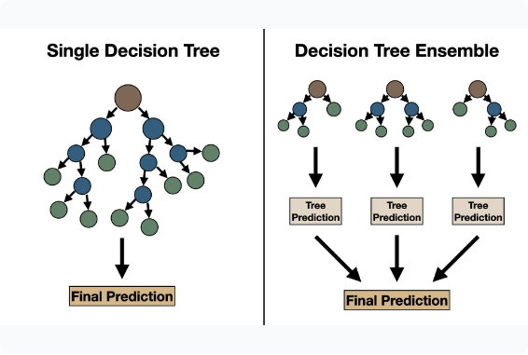


KLH CSE • ML PROJECT 2026
Machine Learning Framework
Classification Workflow Overview
Input Vector: 11 physicochemical attributes extracted per wine sample.
Target Class: Binary decision modeling (0: Standard Quality, 1: Premium Quality).
Evaluation Suite: Multi-metric scoring matrix computed via Scikit-Learn metrics.
F1-Score Formula:
Department of Computer Science & Engineering

Slide 6



KLH CSE • ML PROJECT 2026
Decision Tree Classifier
Algorithm Mechanism
Hyperparameter Configuration
Constructs a non-parametric decision rule hierarchy by recursively partitioning sample feature space based on maximum information gain.
Criterion: Gini Impurity for optimal computational split speed.
Max Depth: Tuned to 6 levels to prevent overfitting on training noise.
Min Samples Split: Set to 5 samples per internal decision node.
Gini Impurity Criterion:
Observation: High interpretability, but prone to high variance on test sets.
Department of Computer Science & Engineering

Slide 7


KLH CSE • ML PROJECT 2026
Random Forest Ensemble
Bagging & Feature Subsampling
Model Characteristics
Builds an ensemble of uncorrelated decision trees trained on bootstrap samples of the dataset.
Num Estimators: 100 decision trees constructed in parallel.
Selects a random subset of features at each split (max_features='sqrt'), reducing inter-tree correlation.
Variance Reduction: Drastically reduces model overfitting compared to a single Decision Tree.
Aggregates tree predictions via majority voting to yield robust final decisions.
Out-of-Bag (OOB): Internal validation capability during bootstrap sampling.
Department of Computer Science & Engineering

Slide 8


KLH CSE • ML PROJECT 2026
Gradient Boosting Model
Sequential Boosting Principles
Tuning & Parameters
Constructs weak learner decision trees sequentially rather than in parallel.
Learning Rate (η): 0.1 to shrink the contribution of each tree.
Each subsequent tree fits directly to the residual errors (pseudo-residuals) of the prior model ensemble.
N-Estimators: 150 sequential boosting iterations.
Subsample: 0.8 for stochastic gradient boosting stability.
Optimizes a differentiable loss function using gradient descent techniques.
Strength: Achieves high accuracy on subtle non-linear chemical interactions.
Department of Computer Science & Engineering

Slide 9

KLH CSE • ML PROJECT 2026
Performance Metrics Comparison
Machine Learning Model | Accuracy | Precision | Recall | F1-Score | Overall Rank
Decision Tree Classifier | 78.4% | 0.76 | 0.75 | 0.75 | Rank 3
Random Forest Classifier | 86.8% | 0.86 | 0.85 | 0.85 | Runner Up
Gradient Boosting Classifier | 89.2% | 0.89 | 0.88 | 0.88 | Best Model
* Evaluation performed on 20% stratified test dataset using Scikit-Learn evaluation suite.
Department of Computer Science & Engineering

Slide 10
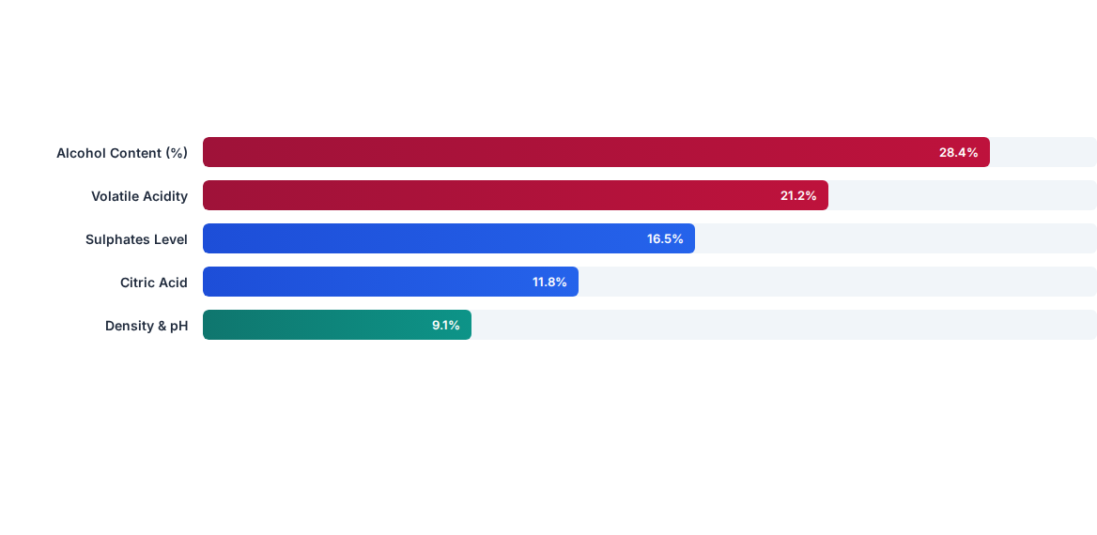
KLH CSE • ML PROJECT 2026
Feature Importance Analysis
Department of Computer Science & Engineering

Slide 11


KLH CSE • ML PROJECT 2026
Technical Specifications
Python 3.10
Scikit-learn
Matplotlib / Seaborn
Google Colab
Core Programming Language
ML Models & Pipeline
EDA & Visualizations
Cloud Execution IDE
Pandas & NumPy
Windows 11
Anaconda / Pip
Wine CSV Dataset
Data Wrangling
Host Environment
Package Management
Physicochemical Data
Department of Computer Science & Engineering

Slide 12


KLH CSE • ML PROJECT 2026
Conclusion & Future Scope
Summary of Findings
Future Scope & Enhancements
Best Performing Model: Gradient Boosting achieved the highest accuracy of 89.2% and F1-score of 0.88.
Web Deployment: Deploy model via Streamlit / Flask web API for real-time vineyard testing.
Ensemble Advantage: Ensemble models (RF and Gradient Boosting) significantly outmatched the single Decision Tree (78.4%).
Deep Learning Exploration: Experiment with Multi-Layer Perceptrons (MLP) for multi-class rating predictions.
Objective Assessment: Confirmed machine learning as a viable, fast alternative to subjective sensory panels.
Expanded Dataset: Incorporate viticulture geographic data and fermentation climate logs.
Department of Computer Science & Engineering

